Slide 1
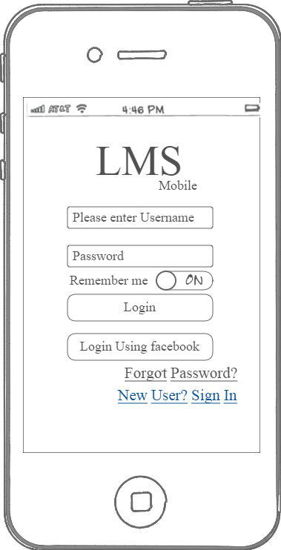
LMS - Login
Notes:
The User Tap on new user Sign In Link to register with the A.
User can register on the App with some fields like first name, last name, email address and selecting the class

Slide 2
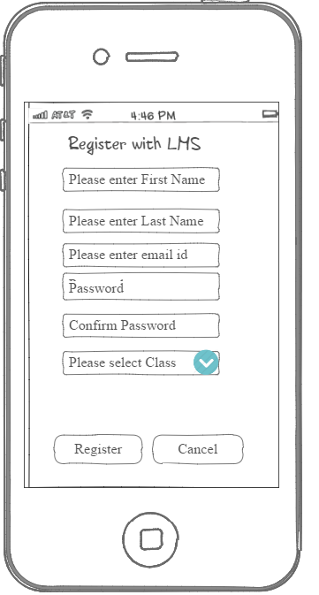
LMS - Registration
Notes:
The User Tap on new user Sign In Link to register with the LMS.
User can register on the App with some fields like first name, last name, email address and selecting the class

Slide 3
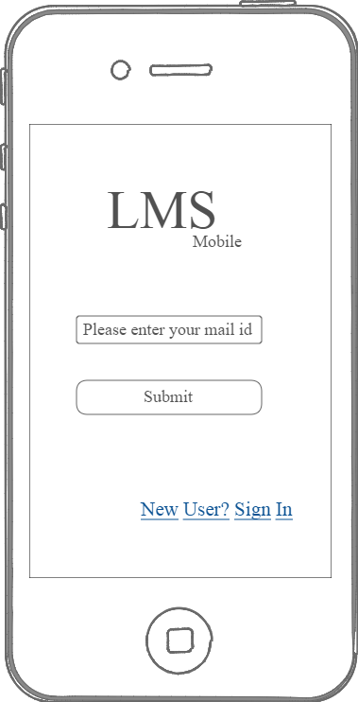
LMS – Forgot Password
Notes:
User can tap on forgot password link to send the password to email.

Slide 4
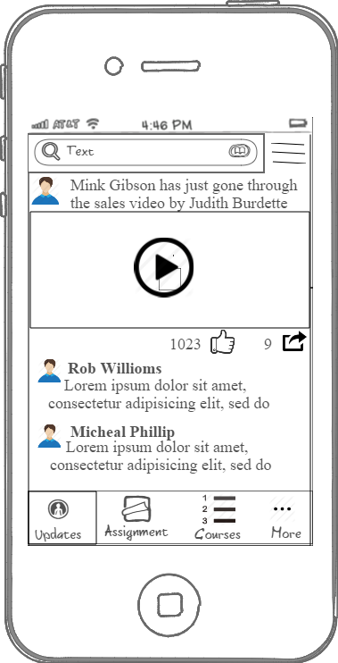
LMS – News Feed after Login
Notes:
Once Logged in, user can see the updates like, courses videos, user feedback, sharing option.
User can also comment on the news feed of the user group.
User can also share the video or certificates on other social sharing apps

Slide 5
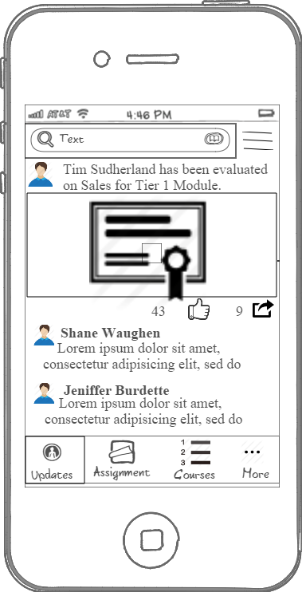
LMS – Scrolling for News feed
Notes:
User can scroll down to see the feeds for pas days and of other users

Slide 6
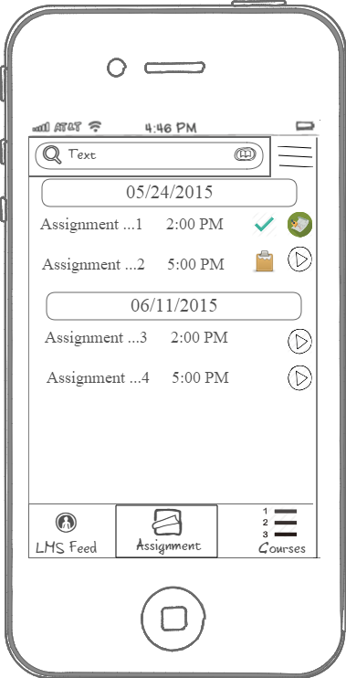
LMS – Assignment
Notes:
The user can tap on Assignment Tab bar to see the home work assignment assigned to the user.
The assignment can be completed, reviewed or yet to be completed.

Slide 7
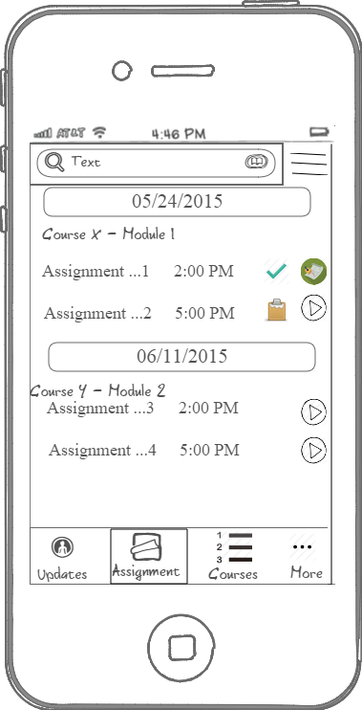
LMS – Assignment
View
Grades
Timely Completed Assignment
Assignment
Not Completed on Scheduled Day
Submit Assignment
Notes:
The user can tap on Assignment Tab bar to see the home work assignment assigned to the user.
The assignment can be completed, reviewed or yet to be completed.

Slide 8
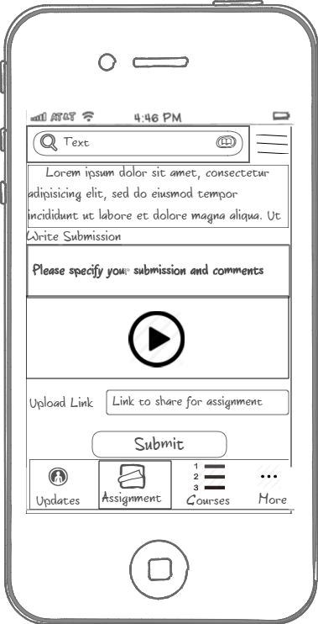
LMS – New Assignment
Notes:
User can tap on pending assignment to submit the video, provide comments and submit it to teacher who have assigned the assignment

Slide 9
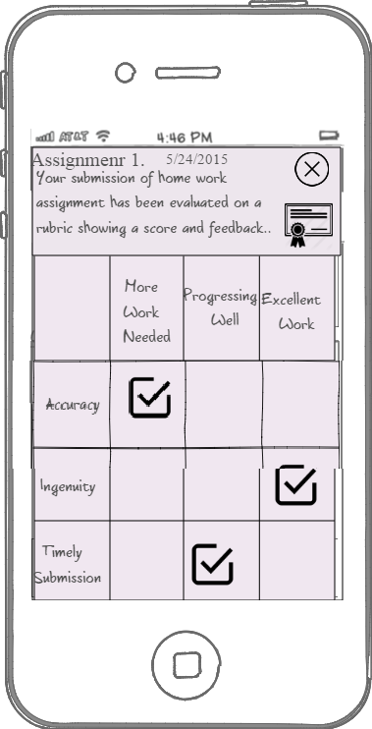
LMS – Reviewed Assignment
Notes:
The user can view the score/grade of the submitted and reviewed assignment

Slide 10
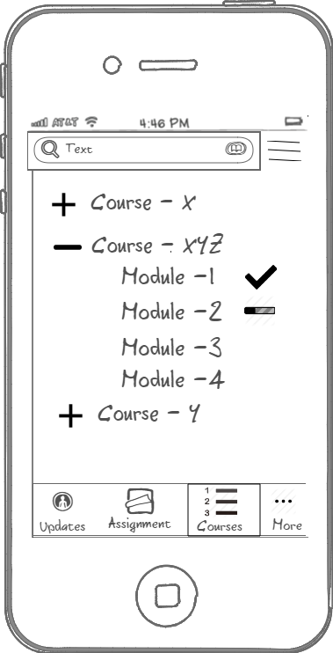
LMS – Course/Modules
Notes:
The user can see the course / modules and its videos uploaded by admin through console

Slide 11
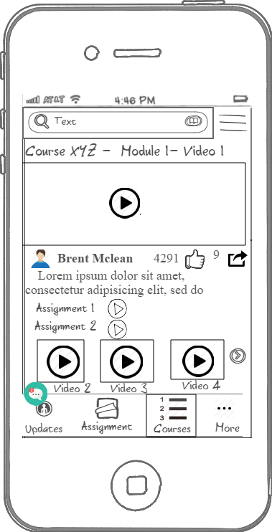
LMS – Course./Module/Videos
Notes:
User can tap on specific module to see the videos of that module.

Slide 12
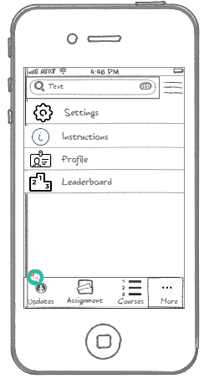
LMS – Course./Module/Videos
Notes:
User can tap on More buttons to see the other options of that module.

